Slide 1
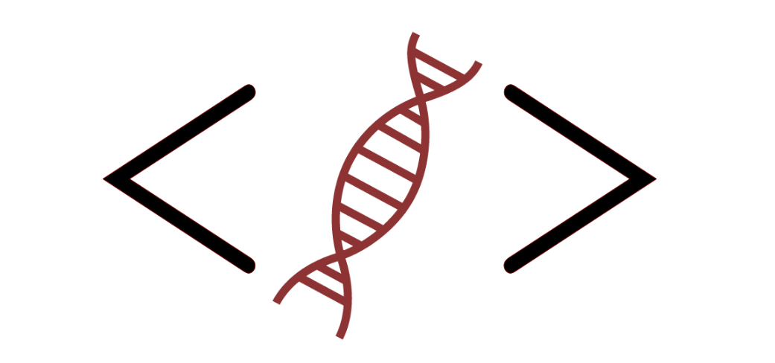
Bioinformatics Bootcamp
Intro to Python for Biomedical Machine Learning
PART I: Python for Data Science
Module 1: Orientation and Intro to Python

Slide 2
Workshop Orientation

Slide 3
Why a workshop?

Slide 4
Why a workshop?
Those who know programming/bioinformatics will be…

Slide 5
Why a workshop?
Those who know programming/bioinformatics will be…
More effective at research

Slide 6
Why a workshop?
Those who know programming/bioinformatics will be…
More effective at research
More competitive for jobs/funding

Slide 7
Why a workshop?
Those who know programming/bioinformatics will be…
More effective at research
More competitive for jobs/funding
More flexible/adaptable to changes in their field

Slide 8
Why a workshop?
Those who know programming/bioinformatics will be…
More effective at research
More competitive for jobs/funding
More flexible/adaptable to changes in their field
There is tremendous interest in formal bioinformatics training... yet, opportunities for such training are sparse.

Slide 9
Why a workshop?
Those who know programming/bioinformatics will be…
More effective at research
More competitive for jobs/funding
More flexible/adaptable to changes in their field
There is tremendous interest in formal bioinformatics training... yet, opportunities for such training are sparse.
Solution: Provide workshops open to all!

Slide 10
But most of all…

Slide 11
Machine learning!

Slide 12
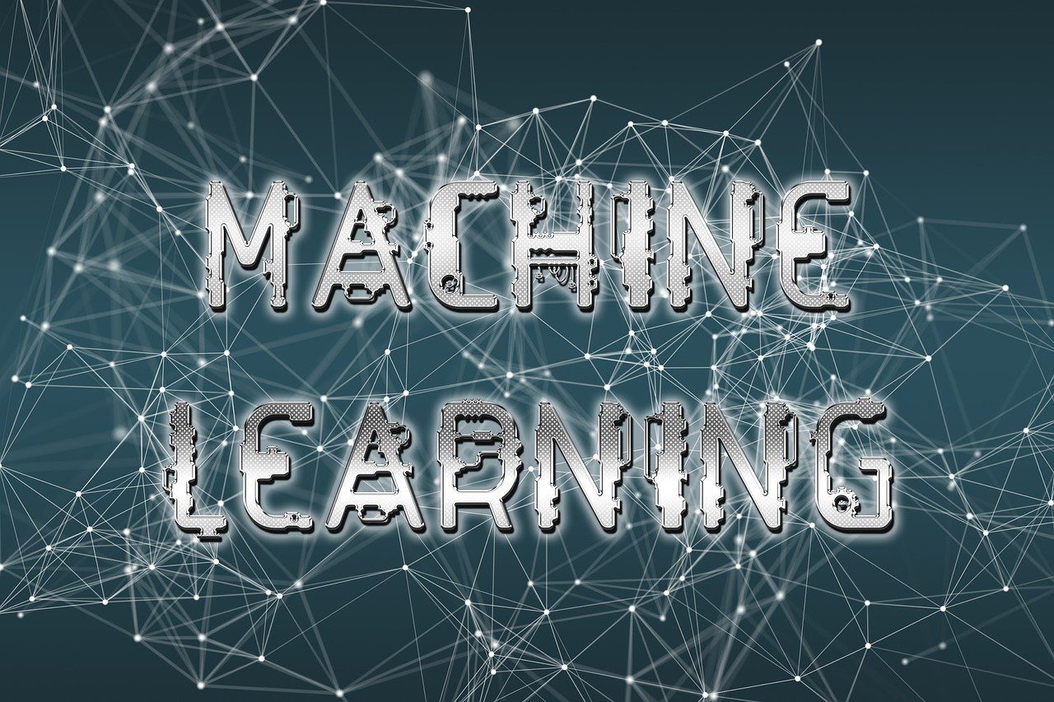
https://cdn.pixabay.com/photo/2019/04/15/12/09/machine-learning-4129175_1280.jpg

Slide 13
Workshop Structure
Most sessions will be roughly 2:1 lecture and hands-on activities.

Slide 14
Workshop Structure
Most sessions will be roughly 2:1 lecture and hands-on activities.
***Lectures will be recorded***

Slide 15
Workshop Structure
Most sessions will be roughly 2:1 lecture and hands-on activities.
***Lectures will be recorded***
Post questions in the chat

Slide 16
Workshop Structure
Most sessions will be roughly 50:50 lecture and hands-on activities.
***Lectures will be recorded***
Post questions in the chat
Outline
PART I: Python for Data Science
PART II: Intro to Biomedical Machine Learning

Slide 17
Workshop Structure
Most sessions will be roughly 50:50 lecture and hands-on activities.
***Lectures will be recorded***
Post questions in the chat
Outline
PART I: Python for Data Science
PART II: Intro to Biomedical Machine Learning

Slide 18
Part I: Python for Data Science

Slide 19
Part I: Python for Data Science
Module #1: Intro to Python Programming

Slide 20
Part I: Python for Data Science
Module #1: Intro to Python Programming
Module #2: Intermediate Python

Slide 21
Part I: Python for Data Science
Module #1: Intro to Python Programming
Module #2: Intermediate Python
Module #3: Python for Data Science

Slide 22
Part I: Python for Data Science
Module #1: Intro to Python Programming
Module #2: Intermediate Python
Module #3: Python for Data Science
Module #4: Review week

Slide 23
Part I: Python for Data Science
From Part I, you will learn:
Data structures
If…Else
Loops
Functions
Numpy/Pandas
Matplotlib
Jupyter Notebook

Slide 24
Workshop Structure
Most sessions will be roughly 50:50 lecture and hands-on activities.
***Lectures will be recorded***
Post questions in the chat
Outline
PART I: Python for Data Science
PART II: Intro to Biomedical Machine Learning

Slide 25
Workshop Structure
Most sessions will be roughly 50:50 lecture and hands-on activities.
***Lectures will be recorded***
Post questions in the chat
Outline
PART I: Python for Data Science
PART II: Intro to Biomedical Machine Learning

Slide 26
Part II: Intro to Biomedical Machine Learning

Slide 27
Part II: Intro to Biomedical Machine Learning
Module #5: Getting to know your data

Slide 28
Part II: Intro to Biomedical Machine Learning
Module #5: Getting to know your data
Module #6: Feature selection and parsimony

Slide 29
Part II: Intro to Biomedical Machine Learning
Module #5: Getting to know your data
Module #6: Feature selection and parsimony
Module #7: Supervised ML models

Slide 30
Part II: Intro to Biomedical Machine Learning
Module #5: Getting to know your data
Module #6: Feature selection and parsimony
Module #7: Supervised ML models
Module #8: End-to-end ML workflows

Slide 31
Part II: Intro to Biomedical Machine Learning
Module #5: Getting to know your data
Module #6: Feature selection and parsimony
Module #7: Supervised ML models
Module #8: End-to-end ML workflows
Module #9: Predicting Leukemia Patient Outcomes Prt I

Slide 32
Part II: Intro to Biomedical Machine Learning
Module #5: Getting to know your data
Module #6: Feature selection and parsimony
Module #7: Supervised ML models
Module #8: End-to-end ML workflows
Module #9: Predicting Leukemia Patient Outcomes Prt I
Module #10: Predicting Leukemia Patient Outcomes Prt II

Slide 33
Part II: Intro to Biomedical Machine Learning
Module #5: Getting to know your data
Module #6: Feature selection and parsimony
Module #7: Supervised ML models
Module #8: End-to-end ML workflows
Module #9: Predicting Leukemia Patient Outcomes Prt I
Module #10: Predicting Leukemia Patient Outcomes Prt II
Module #11: Intro to Computer Vision for Biomedical Applications

Slide 34
Part II: Intro to Biomedical Machine Learning
Module #5: Getting to know your data
Module #6: Feature selection and parsimony
Module #7: Supervised ML models
Module #8: End-to-end ML workflows
Module #9: Predicting Leukemia Patient Outcomes Prt I
Module #10: Predicting Leukemia Patient Outcomes Prt II
Module #11: Intro to Computer Vision for Biomedical Applications
Module #12: Advanced Topics

Slide 35
Part II: Intro to Biomedical Machine Learning
From Part II, you will learn:
Exploratory data analysis
Feature selection
Regression models
Classification models
ML Workflows
Image processing
Introductory Deep learning

Slide 36
Part II: Intro to Biomedical Machine Learning
From Part II, you will learn:
Exploratory data analysis
Feature selection
Regression models
Classification models
ML Workflows
Image processing
Introductory Deep learning
By the end, you will gain the Skills/Confidence to use Python and ML in your research!

Slide 37
How to succeed in this workshop

Slide 38
How to succeed in this workshop
Complete the assignments in DataCamp

Slide 39
How to succeed in this workshop
Complete the assignments in DataCamp
Pursue outside learning (e.g., codecademy, online books, etc)

Slide 40
How to succeed in this workshop
Complete the assignments in DataCamp
Pursue outside learning (e.g., codecademy, online books, etc)
Communicate with your instructors
Email any time and attend Zoom office hours (listed in the syllabus)

Slide 41
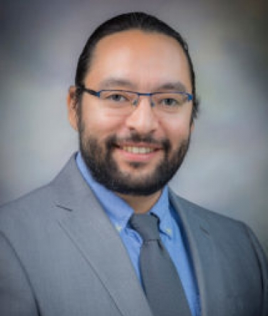
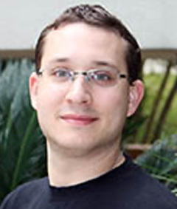

Meet your instructors
Daniel Montemayor, PhD
Assistant Professor
Center for Renal Precision Medicine
Department of Medicine
Simon Levy
5th-year PhD Student
Henry Miller
3rd-year PhD Student

Slide 42

About BIG club
Bioinformatics Interest Group (BIG) is a new UT Health SA club promoting student engagement with bioinformatics.
Leadership
President: Muku Bhandari
Vice President: Victoria Alers
Secretary: Paul Ramirez
Training committee chair: Henry Miller
Historian: Aiola Stoja
Treasurer: Meilinn Tram
All UT Health SA students are welcome to join!

Slide 43
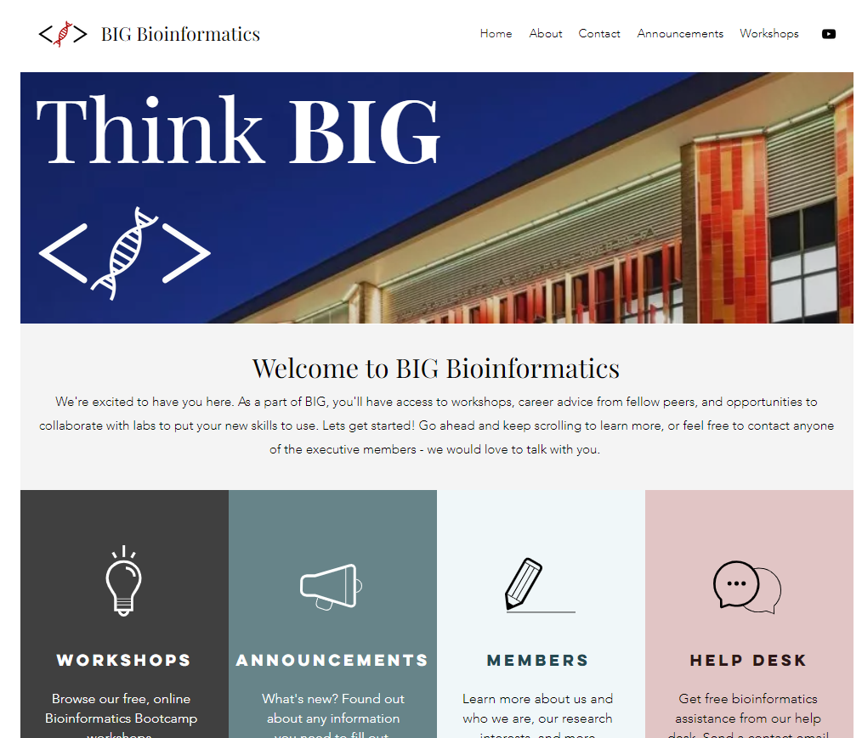
https://www.bigbioinformatics.org/

Slide 44
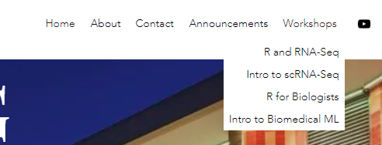
https://www.bigbioinformatics.org/

Slide 45
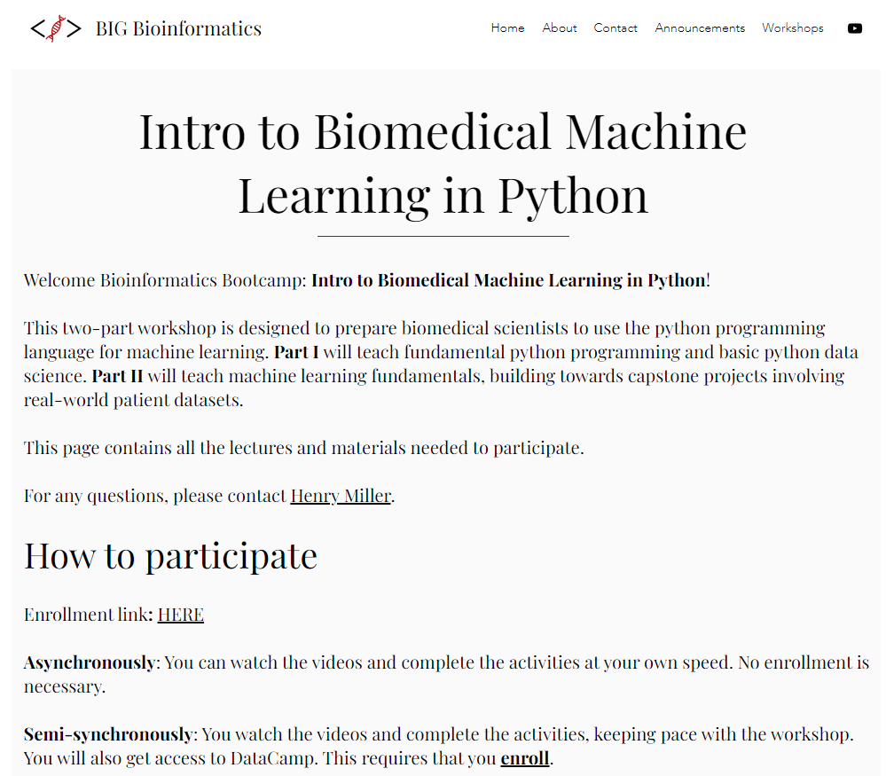
https://www.bigbioinformatics.org/

Slide 46
Introduction
Why should you learn machine learning?

Slide 47
https://cdn.pixabay.com/photo/2019/04/15/12/09/machine-learning-4129175_1280.jpg

Slide 48
Typical biology / bioinformatics workflow

Slide 49
Typical biology / bioinformatics workflow
Have a biological question

Slide 50
Typical biology / bioinformatics workflow
Have a biological question
Generate a hypothesis

Slide 51
Typical biology / bioinformatics workflow
Have a biological question
Generate a hypothesis
Do exploratory analysis

Slide 52
Typical biology / bioinformatics workflow
Have a biological question
Generate a hypothesis
Do exploratory analysis
Do confirmatory experiments

Slide 53
Typical biology / bioinformatics workflow
Have a biological question
Generate a hypothesis
Do exploratory analysis
Do confirmatory experiments
Publish

Slide 54
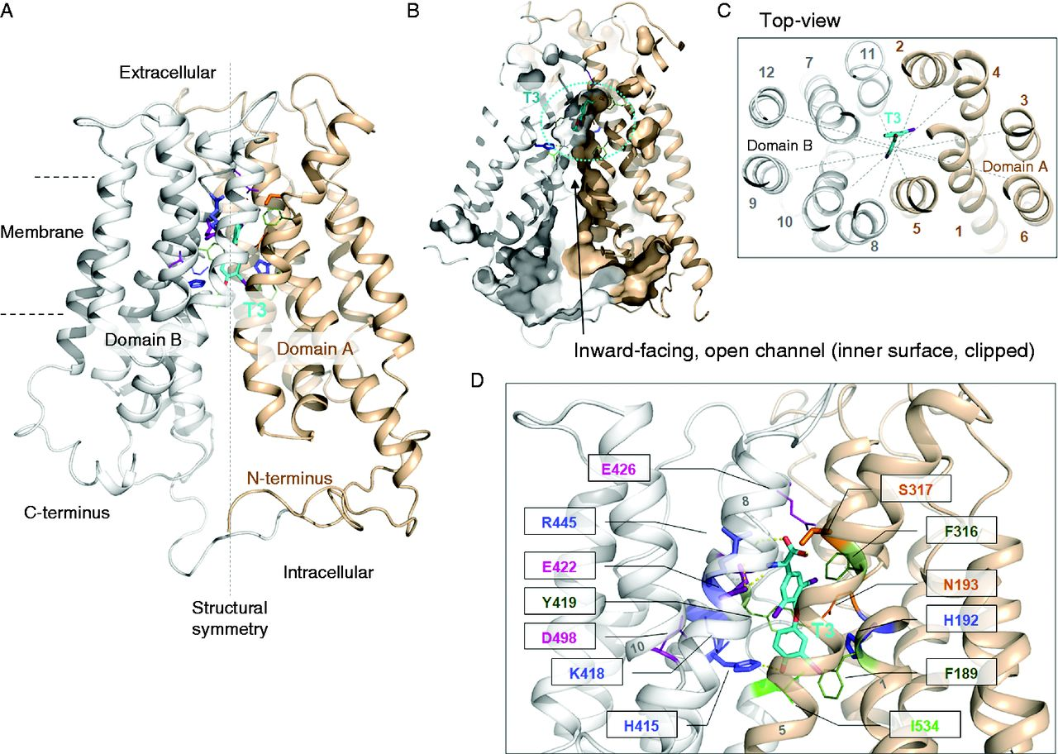
Fischer J., et al. Modulation of monocarboxylate transporter 8 oligomerization by specific pathogenic mutations. Journal of Molecular Endocrinology. 2015, 54(1):39-50. PubMed ID: 25527620

Slide 55
:(
Fischer J., et al. Modulation of monocarboxylate transporter 8 oligomerization by specific pathogenic mutations. Journal of Molecular Endocrinology. 2015, 54(1):39-50. PubMed ID: 25527620

Slide 56


…?

Slide 57
Gepia2 Demo

Slide 58
:(
Fischer J., et al. Modulation of monocarboxylate transporter 8 oligomerization by specific pathogenic mutations. Journal of Molecular Endocrinology. 2015, 54(1):39-50. PubMed ID: 25527620

Slide 59
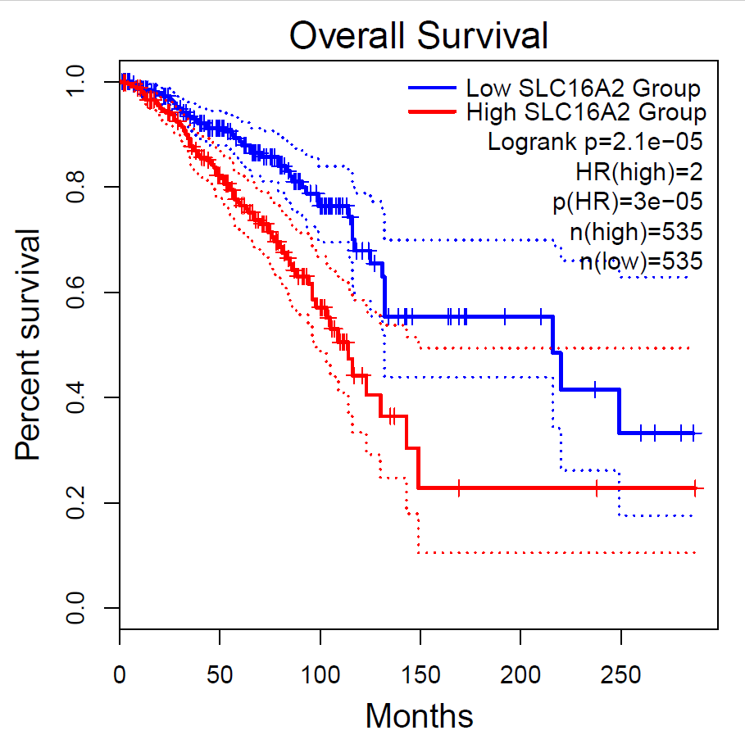

Slide 60
:(
Probably…
Fischer J., et al. Modulation of monocarboxylate transporter 8 oligomerization by specific pathogenic mutations. Journal of Molecular Endocrinology. 2015, 54(1):39-50. PubMed ID: 25527620

Slide 61
Typical biology / bioinformatics workflow
Have a biological question
Generate a hypothesis
Do exploratory analysis
Do confirmatory experiments
Publish

Slide 62
Typical biology / bioinformatics workflow
Have a biological question
Generate a hypothesis
Do exploratory analysis
Do confirmatory experiments
Publish

Slide 63
Typical biology / bioinformatics workflow
Have a biological question
Generate a hypothesis
Do exploratory analysis
Do confirmatory experiments
Publish

Slide 64
Typical biology / bioinformatics workflow
Have a biological question
Generate a hypothesis
Do exploratory analysis
Do confirmatory experiments
Publish

Slide 65
Typical biology / bioinformatics workflow
Have a biological question
Generate a hypothesis
Do exploratory analysis
Do confirmatory experiments
Publish
:)

Slide 66
:(
Fischer J., et al. Modulation of monocarboxylate transporter 8 oligomerization by specific pathogenic mutations. Journal of Molecular Endocrinology. 2015, 54(1):39-50. PubMed ID: 25527620

Slide 67
What if we could use this information to save lives?

Slide 68
What if we could use this information to save lives?
Could we predict…
patient outcome?
drug efficacy?
remission rate?

Slide 69
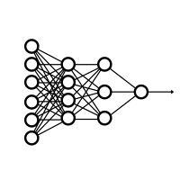


X
Biopsy Tumor
Predict outcomes
Y
Measure expression
(aka, “features”)
Provide personalized care

Slide 70
Biomedical Machine Learning
A logical extension of classical biomedical research
Enables precision medicine
Saves lives

Slide 71
What is machine learning?

Slide 72
What is ML?
Industrial revolution metaphor?
Resource, not a revolution
Data is the crude oil
Feature engineering is refining
General-purpose problem-solving approach
Survey of tools and the kinds of problems you can answer with them
Preview
Self driving car – image recognition
Precision medicine – biomarkers
Stock market – time series analysis

Slide 73
Workshop workflow

Slide 74
Workshop workflow and beyond…
Basics
Functional Coding
DataSci skills
ML Skills (Prt II)
Predict Leukemia Outcomes project
Computer Vision and Advanced topics

Slide 75
Workshop workflow and beyond…
Basics
Functional Coding
DataSci skills
ML Skills (Prt II)
Predict Leukemia Outcomes project
Electrophysiology Analysis
scRNA-Seq
Protein Interaction network analysis
Drug PK/PD and synergy analysis
Literature Mining
ChIP-Seq / HiC-Seq
Computer Vision and Advanced topics
Structural modeling
Population health
Machine learning
Etc…
Image processing
Clinical data analysis
Things you can do with data science skills in Python

Slide 76
Workshop workflow and beyond…
Basics
Functional Coding
DataSci skills
ML Skills (Prt II)
Predict Leukemia Outcomes project
Computer Vision and Advanced topics

Slide 77
Workshop workflow and beyond…
Basics
Functional Coding
DataSci skills
ML Skills (Prt II)
Predict Leukemia Outcomes project
Computer Vision and Advanced topics

Slide 78

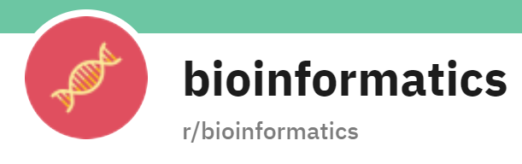



Where to get help

Slide 79
Introduction to Python

Slide 80
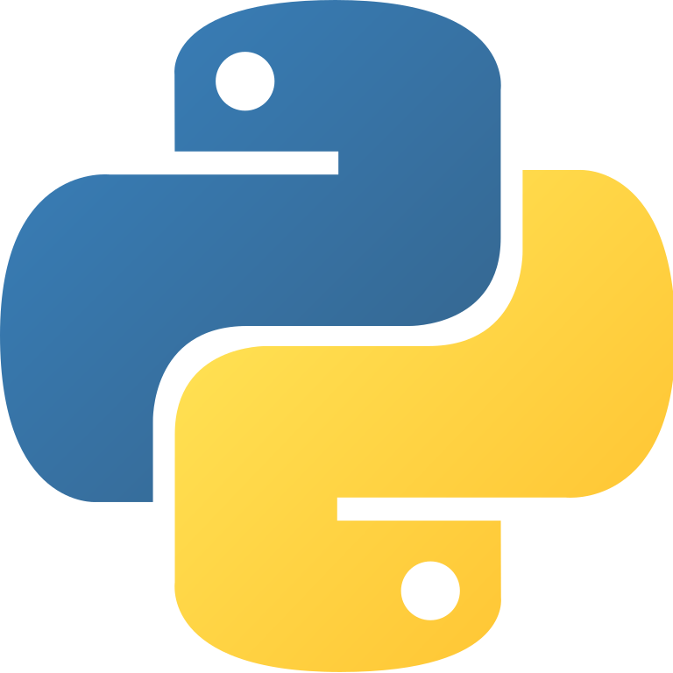
What is Python?
Programming language first released in 1994
Named after Monty Python’s Flying Circus
Features:
Object oriented
Interpreted
Designed for general programming
Easily extended with packages
Called “the glue” because it connects legacy programs together with modern applications

Slide 81
Setting up Python

Slide 82
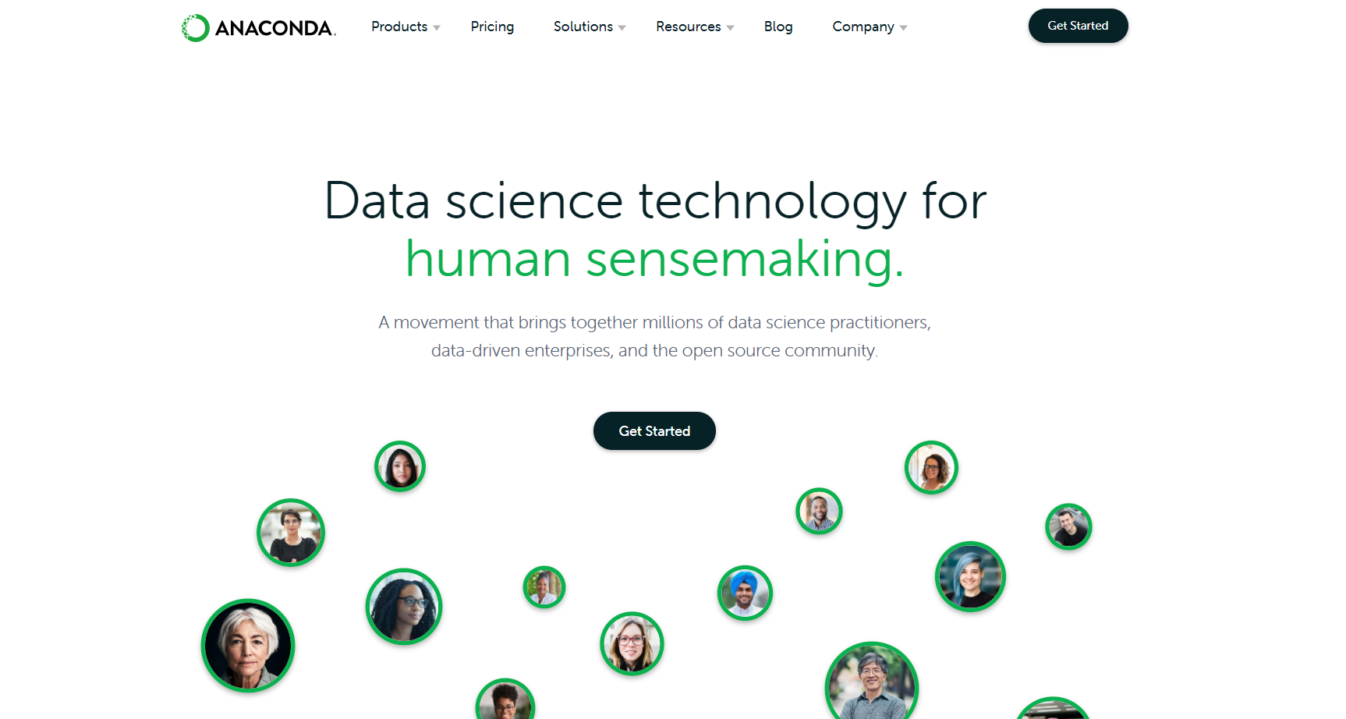

Slide 83
Questions?
Activity: Complete Introductory Python course in DataCamp

